Slide 1
DCIT 212 NUMERICAL AND COMPUTATIONAL METHODS
Session 3 – Eigenproblems - Part I
Lecturer: Justice K. Appati, PhD., UG, DCS
Contact Information: jkappati@ug.edu.gh

Slide 2
Course Information
Provide the following information:
Course Code: | DCIT 212
Course Title: | Numerical and Computational Methods
Course Credit | 3
Session Number & Session Title: | 3 & Eigenproblems - Part I
Semester/Year: | 2 / 2021

Slide 3
Course Information (contd.)
Provide the following information:
Lecture Period(s) | 2
Prerequisites | DCIT 105: Mathematics for IT Professionals
Teaching Assistant | TBD

Slide 4
Course Instructor’s Contact
Provide the following information:
Course Instructor(s) Name | Justice K. Appati, PhD.
Office Location | Stat 010, Statistics Building
Office Hours | TBD
Phone | N/A
E-mail | jkappati@ug.edu.gh

Slide 5
Session Overview
This session explore the characteristics of eigenproblems. It also look at how the power and direct method works in estimating the eigenvalue of a system.

Slide 6
Session Outline
Mathematical Characteristics of Eigenproblems
Direct Power Method
Inverse Power Method
The Direct Method

Slide 7
Learning Objectives
After completing this session, you will be able to:
Explain the mathematical characteristics of eigenproblems.
Solve the linear eigenproblem using the direct power method.
Explain the basis of the power method.
Identify when to apply the inverse power method.
Solve nonlinear eigenproblem with the direct method.

Slide 8
Session Activities and Assignments
This week, complete the following tasks:
Log onto the UG Sakai LMS course site: http://sakai.ug.edu.gh/
Read Chapter 2 (Pages 81-103) of the Recommended Textbook – Joe D. Hoffman (2001), Numerical Methods for Engineers and Scientists (2nd Edition).
Review Lecture Slides: Session 3 – Eigenproblems - Part I
Visit the Chat Room and discuss the Forum question for Session 3
Complete the Individual Assignment for Session 3

Slide 9
Reading List
Read Chapter 2 (Pages 81-103) of the Recommended Textbook – Joe D. Hoffman (2001), Numerical Methods for Engineers and Scientists (2nd Edition).

Slide 10
Mathematical Characteristics OF EIGENPROBLEMS
Topic One

Slide 11
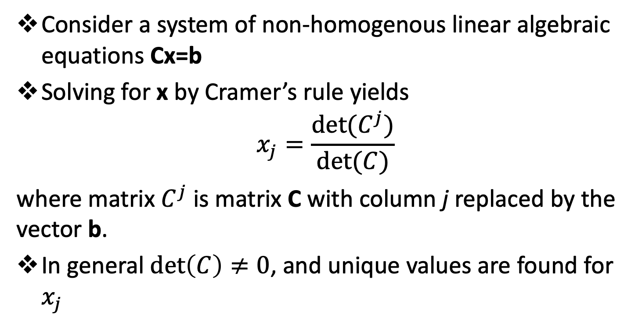
Mathematical Characteristics of Eigenproblems
Consider a system of non-homogenous linear algebraic equations Cx=b
Solving for x by Cramer’s rule yields
$$x_{j}=\frac{det⁡(C^{j})}{det⁡(C)}$$
where matrix $C^{j}$ is matrix C with column j replaced by the vector b.
In general $\det\left(C\right)≠0$, and unique values are found for $x_{j}$

Slide 12
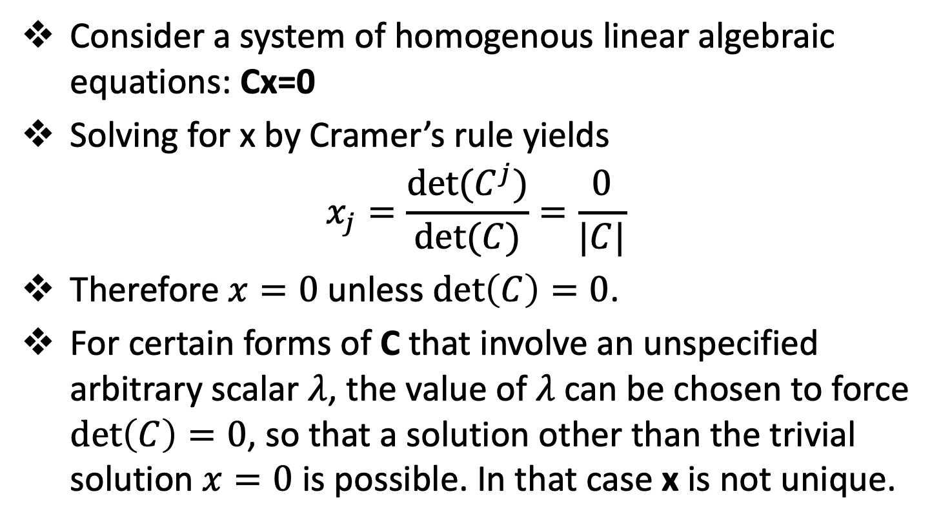
Mathematical Characteristics of Eigenproblems
Consider a system of homogenous linear algebraic equations: Cx=0
Solving for x by Cramer’s rule yields
$$x_{j}=\frac{det⁡(C^{j})}{det⁡(C)}=\frac{0}{|C|}$$
Therefore $x=0$ unless $\det\left(C\right)=0$.
For certain forms of C that involve an unspecified arbitrary scalar $λ$, the value of $λ$ can be chosen to force $\det\left(C\right)=0$, so that a solution other than the trivial solution $x=0$ is possible. In that case x is not unique.

Slide 13
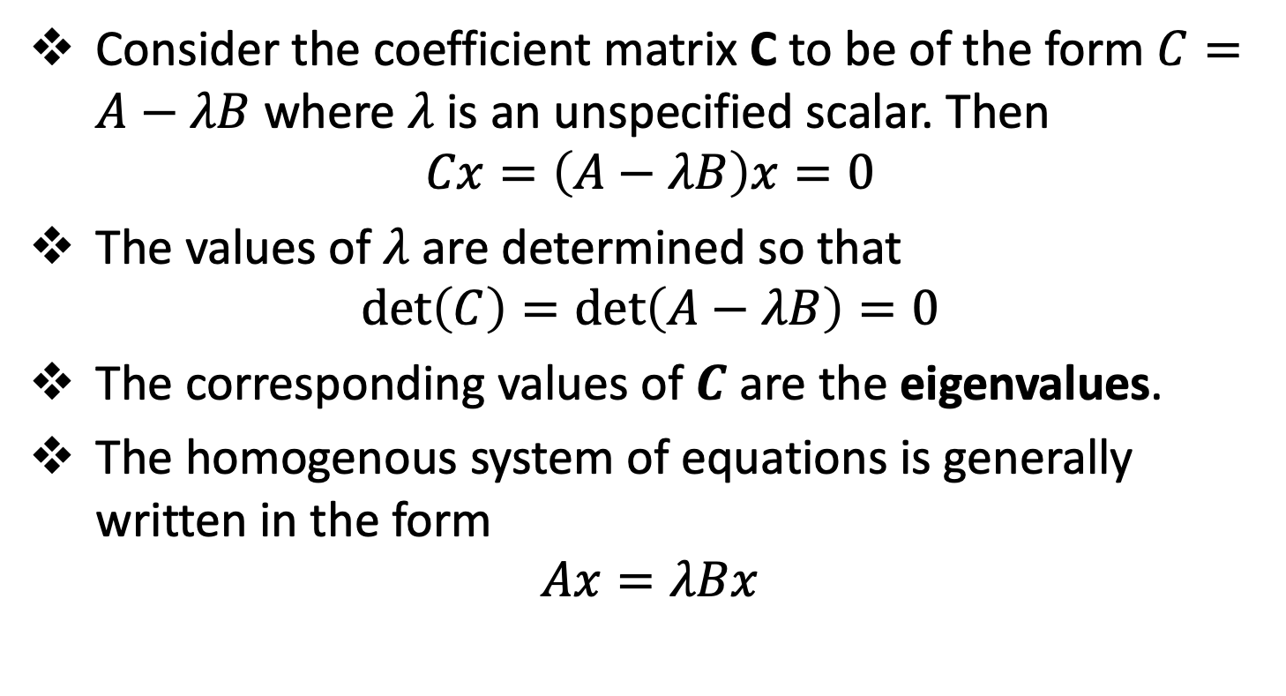
Mathematical Characteristics of Eigenproblems
Consider the coefficient matrix C to be of the form $C=A−λB$ where $λ$ is an unspecified scalar. Then
$$Cx=\left(A−λB\right)x=0$$
The values of $λ$ are determined so that
$$\det\left(C\right)=\det\left(A−λB\right)=0$$
The corresponding values of $C$ are the eigenvalues.
The homogenous system of equations is generally written in the form
$$Ax=λBx$$

Slide 14
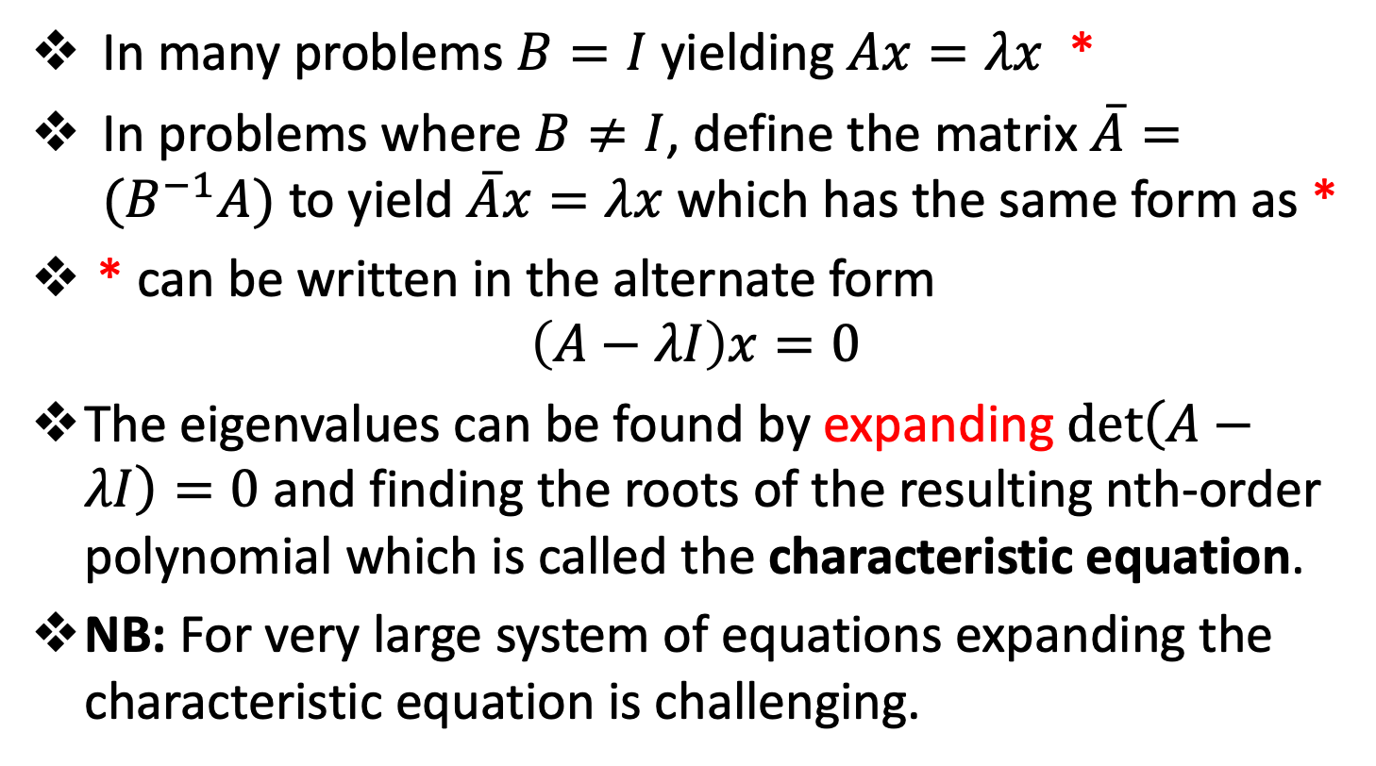
Mathematical Characteristics of Eigenproblems
In many problems $B=I$ yielding $Ax=λx$ *
In problems where $B≠I$, define the matrix $\overline{A}=(B^{−1}A)$ to yield $\overline{A}x=λx$ which has the same form as *
* can be written in the alternate form
$$\left(A−λI\right)x=0$$
The eigenvalues can be found by expanding $\det\left(A−λI\right)=0$ and finding the roots of the resulting nth-order polynomial which is called the characteristic equation.
NB: For very large system of equations expanding the characteristic equation is challenging.

Slide 15
The Power Method
Topic Two

Slide 16
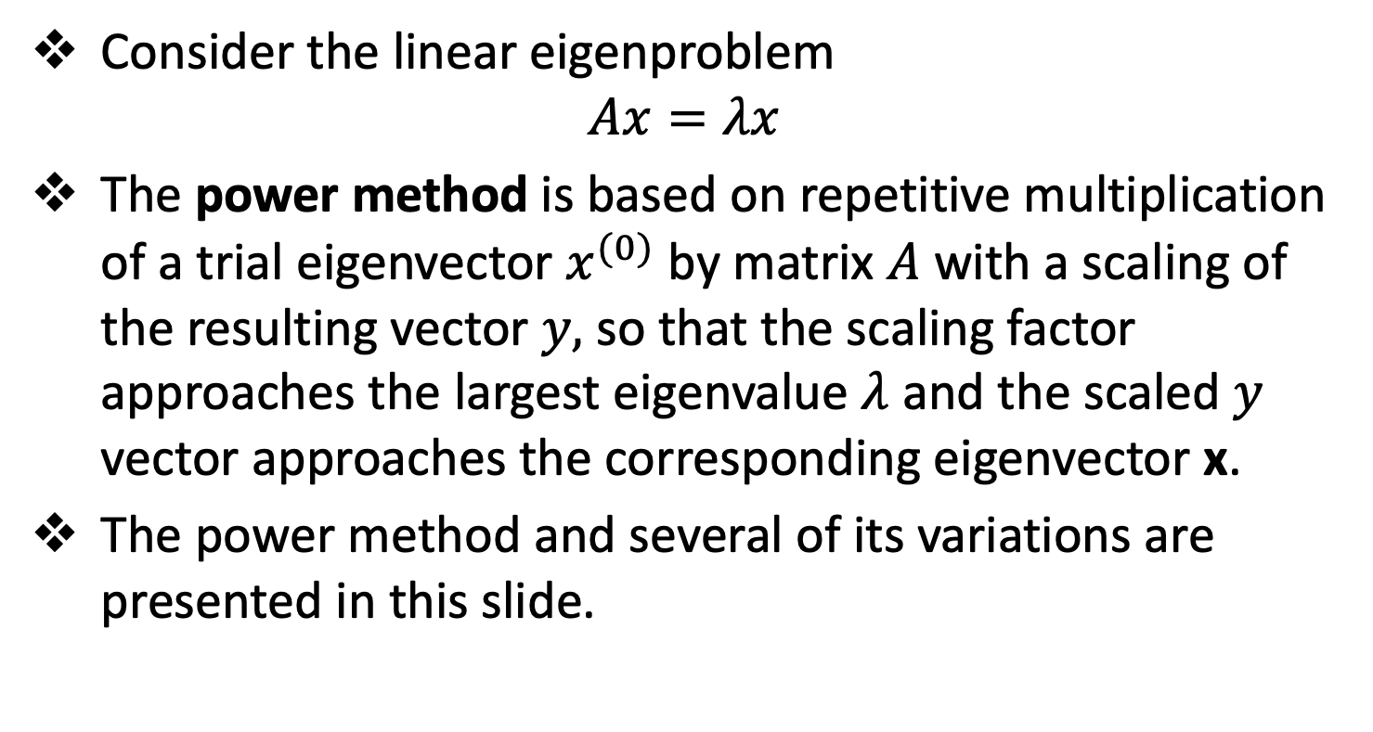
Introduction
Consider the linear eigenproblem
$$Ax=λx$$
The power method is based on repetitive multiplication of a trial eigenvector $x^{(0)}$ by matrix $A$ with a scaling of the resulting vector $y,$ so that the scaling factor approaches the largest eigenvalue $λ$ and the scaled $y$ vector approaches the corresponding eigenvector x.
The power method and several of its variations are presented in this slide.

Slide 17
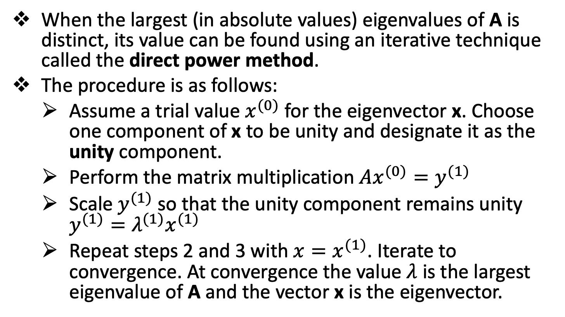
The Direct Power Method
When the largest (in absolute values) eigenvalues of A is distinct, its value can be found using an iterative technique called the direct power method.
The procedure is as follows:
Assume a trial value $x^{(0)}$ for the eigenvector x. Choose one component of x to be unity and designate it as the unity component.
Perform the matrix multiplication $Ax^{(0)}=y^{(1)}$
Scale $y^{(1)}$ so that the unity component remains unity $y^{(1)}=λ^{(1)}x^{(1)}$
Repeat steps 2 and 3 with $x=x^{(1)}$. Iterate to convergence. At convergence the value $λ$ is the largest eigenvalue of A and the vector x is the eigenvector.

Slide 18
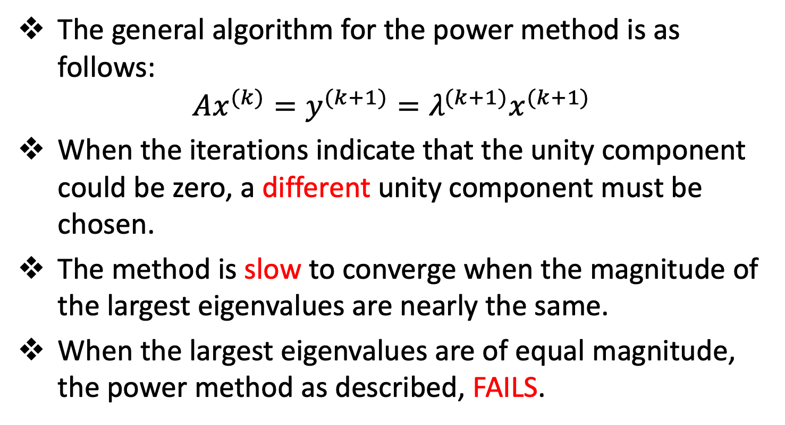
The Direct Power Method
The general algorithm for the power method is as follows:
$$Ax^{(k)}=y^{(k+1)}=λ^{(k+1)}x^{(k+1)}$$
When the iterations indicate that the unity component could be zero, a different unity component must be chosen.
The method is slow to converge when the magnitude of the largest eigenvalues are nearly the same.
When the largest eigenvalues are of equal magnitude, the power method as described, FAILS.

Slide 19
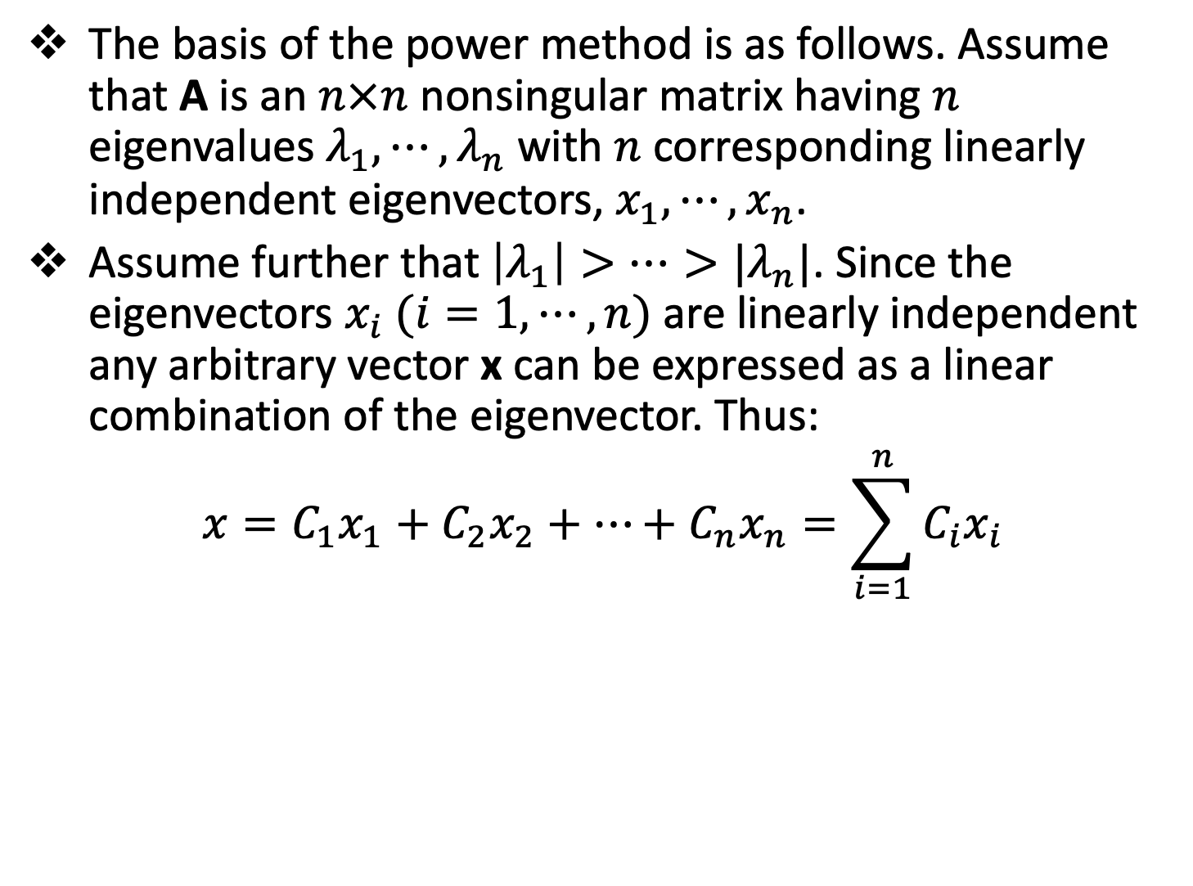
Basis of the Power Method
The basis of the power method is as follows. Assume that A is an $n×n$ nonsingular matrix having $n$ eigenvalues $λ_{1},⋯,λ_{n}$ with $n$ corresponding linearly independent eigenvectors, $x_{1},⋯,x_{n}$.
Assume further that $\left|λ_{1}\right|>⋯>|λ_{n}|$. Since the eigenvectors $x_{i} (i=1,⋯,n)$ are linearly independent any arbitrary vector x can be expressed as a linear combination of the eigenvector. Thus:
$$x=C_{1}x_{1}+C_{2}x_{2}+⋯+C_{n}x_{n}=\sum_{i=1}^{n}{C_{i}x_{i}}$$

Slide 20
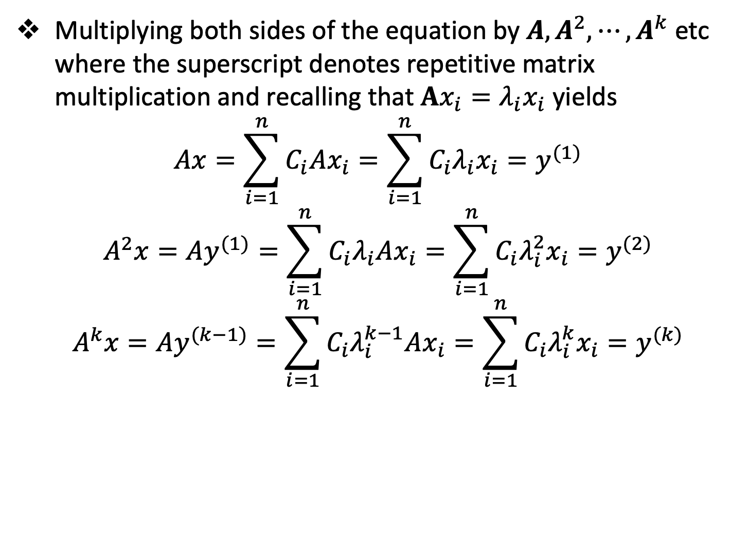
Basis of the Power Method
Multiplying both sides of the equation by $A,A^{2},⋯,A^{k}$ etc where the superscript denotes repetitive matrix multiplication and recalling that $Ax_{i}=λ_{i}x_{i}$ yields
$$Ax=\sum_{i=1}^{n}{C_{i}Ax_{i}}=\sum_{i=1}^{n}{C_{i}λ_{i}x_{i}}=y^{(1)}$$
$$A^{2}x=Ay^{(1)}=\sum_{i=1}^{n}{C_{i}λ_{i}Ax_{i}}=\sum_{i=1}^{n}{C_{i}λ_{i}^{2}x_{i}}=y^{(2)}$$
$$A^{k}x=Ay^{(k−1)}=\sum_{i=1}^{n}{C_{i}λ_{i}^{k−1}Ax_{i}}=\sum_{i=1}^{n}{C_{i}λ_{i}^{k}x_{i}}=y^{(k)}$$

Slide 21
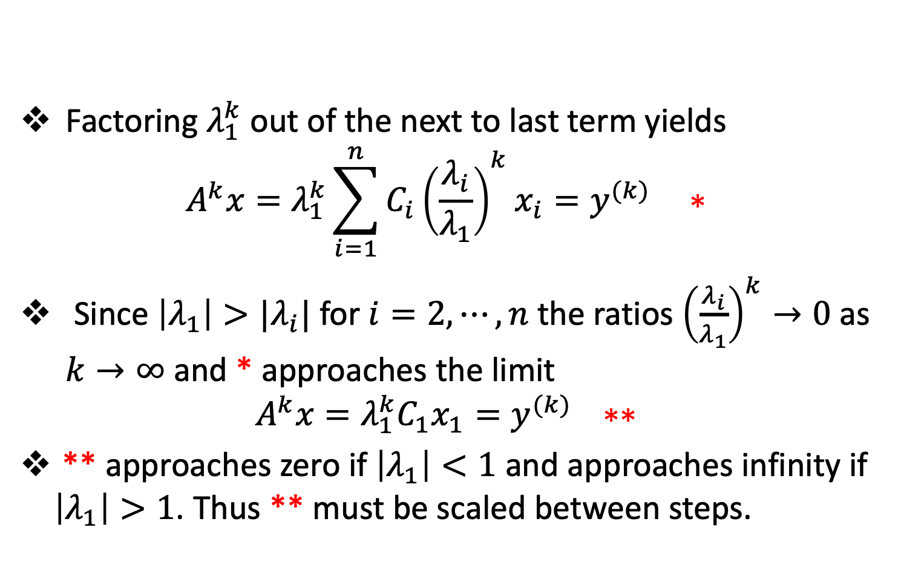
Basis of the Power Method
Factoring $λ_{1}^{k}$ out of the next to last term yields
$$A^{k}x=λ_{1}^{k}\sum_{i=1}^{n}{C_{i}{\left(\frac{λ_{i}}{λ_{1}}\right)}^{k}x_{i}}=y^{(k)} ∗$$
Since $\left|λ_{1}\right|>{|λ}_{i}|$ for $i=2,⋯,n$ the ratios ${\left(\frac{λ_{i}}{λ_{1}}\right)}^{k}→0$ as $k→∞$ and * approaches the limit
$$A^{k}x=λ_{1}^{k}C_{1}x_{1}=y^{(k)} ∗∗$$
** approaches zero if $\left|λ_{1}\right|<1$ and approaches infinity if $\left|λ_{1}\right|>1$. Thus ** must be scaled between steps.

Slide 22
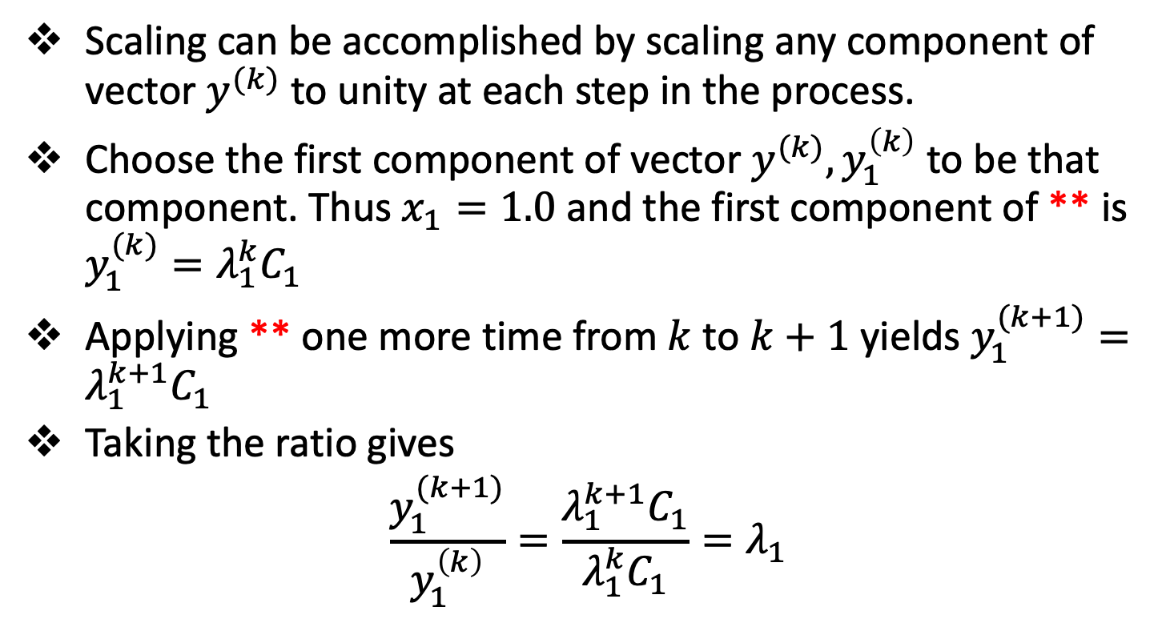
Basis of the Power Method
Scaling can be accomplished by scaling any component of vector $y^{(k)}$ to unity at each step in the process.
Choose the first component of vector $y^{(k)},y_{1}^{\left(k\right)}$ to be that component. Thus $x_{1}=1.0$ and the first component of ** is $y_{1}^{(k)}=λ_{1}^{k}C_{1}$
Applying ** one more time from $k$ to $k+1$ yields $y_{1}^{(k+1)}=λ_{1}^{k+1}C_{1}$
Taking the ratio gives
$$\frac{y_{1}^{(k+1)}}{y_{1}^{\left(k\right)}}=\frac{λ_{1}^{k+1}C_{1}}{λ_{1}^{k}C_{1}}=λ_{1}$$

Slide 23
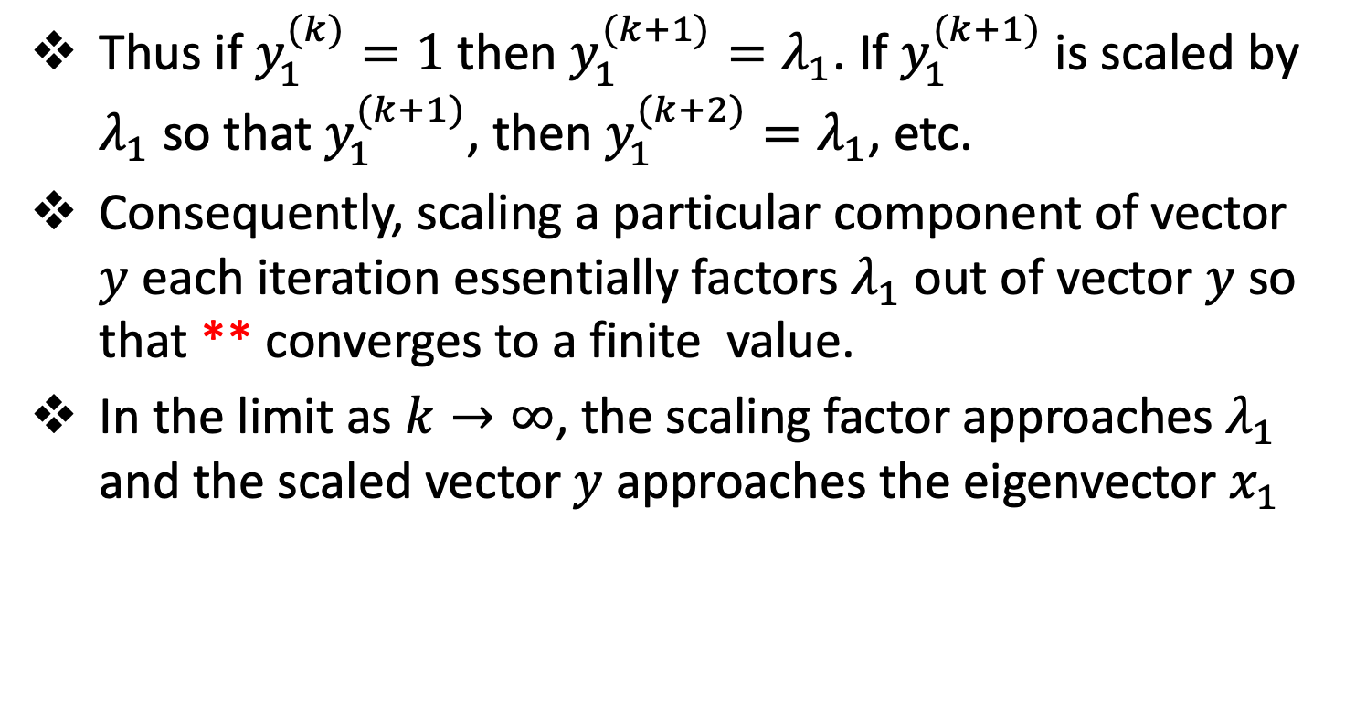
Basis of the Power Method
Thus if $y_{1}^{(k)}=1$ then $y_{1}^{(k+1)}=λ_{1}$. If $y_{1}^{(k+1)}$ is scaled by $λ_{1}$ so that $y_{1}^{(k+1)}$, then $y_{1}^{(k+2)}=λ_{1}$, etc.
Consequently, scaling a particular component of vector $y$ each iteration essentially factors $λ_{1}$ out of vector $y$ so that ** converges to a finite value.
In the limit as $k→∞$, the scaling factor approaches $λ_{1}$ and the scaled vector $y$ approaches the eigenvector $x_{1}$

Slide 24
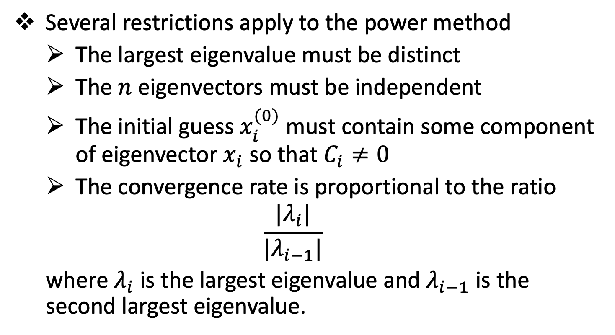
Basis of the Power Method
Several restrictions apply to the power method
The largest eigenvalue must be distinct
The $n$ eigenvectors must be independent
The initial guess $x_{i}^{(0)}$ must contain some component of eigenvector $x_{i}$ so that $C_{i}≠0$
The convergence rate is proportional to the ratio
$$\frac{|λ_{i}|}{|λ_{i−1}|}$$
where $λ_{i}$ is the largest eigenvalue and $λ_{i−1}$ is the second largest eigenvalue.

Slide 25
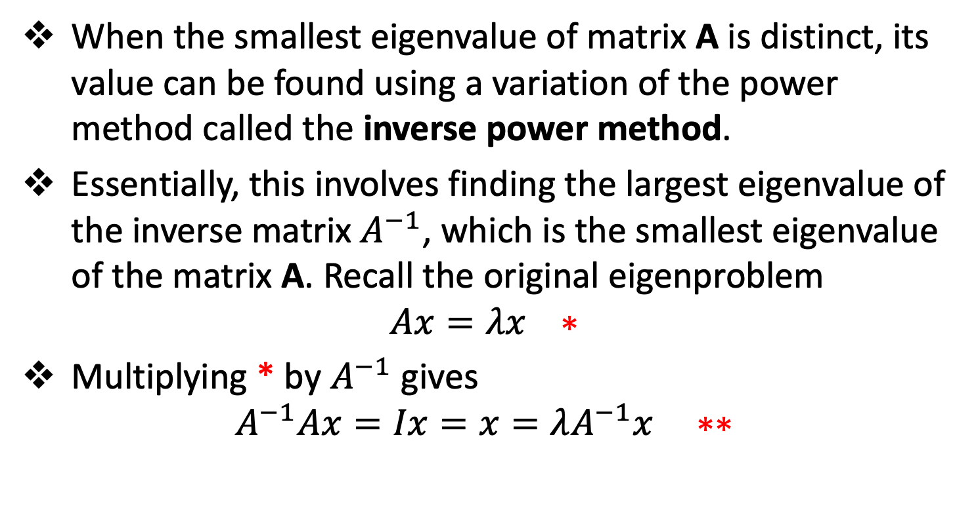
The Inverse Power Method
When the smallest eigenvalue of matrix A is distinct, its value can be found using a variation of the power method called the inverse power method.
Essentially, this involves finding the largest eigenvalue of the inverse matrix $A^{−1}$, which is the smallest eigenvalue of the matrix A. Recall the original eigenproblem
$$Ax=λx ∗$$
Multiplying * by $A^{−1}$ gives
$$A^{−1}Ax=Ix=x=λA^{−1}x ∗∗$$

Slide 26
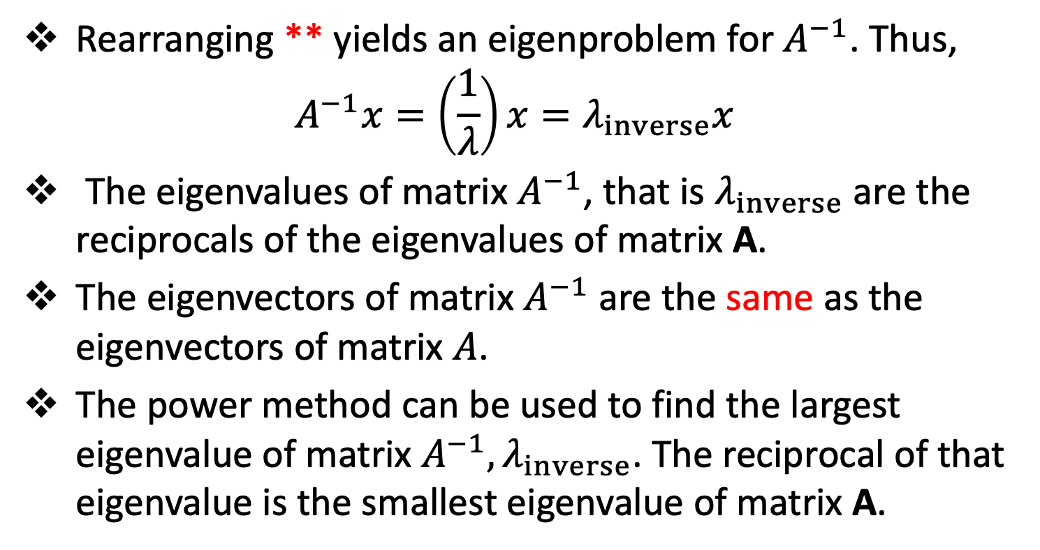
The Inverse Power Method
Rearranging ** yields an eigenproblem for $A^{−1}$. Thus,
$$A^{−1}x=\left(\frac{1}{λ}\right)x=λ_{inverse}x$$
The eigenvalues of matrix $A^{−1}$, that is $λ_{inverse}$ are the reciprocals of the eigenvalues of matrix A.
The eigenvectors of matrix $A^{−1}$ are the same as the eigenvectors of matrix $A$.
The power method can be used to find the largest eigenvalue of matrix $A^{−1},λ_{inverse}$. The reciprocal of that eigenvalue is the smallest eigenvalue of matrix A.

Slide 27
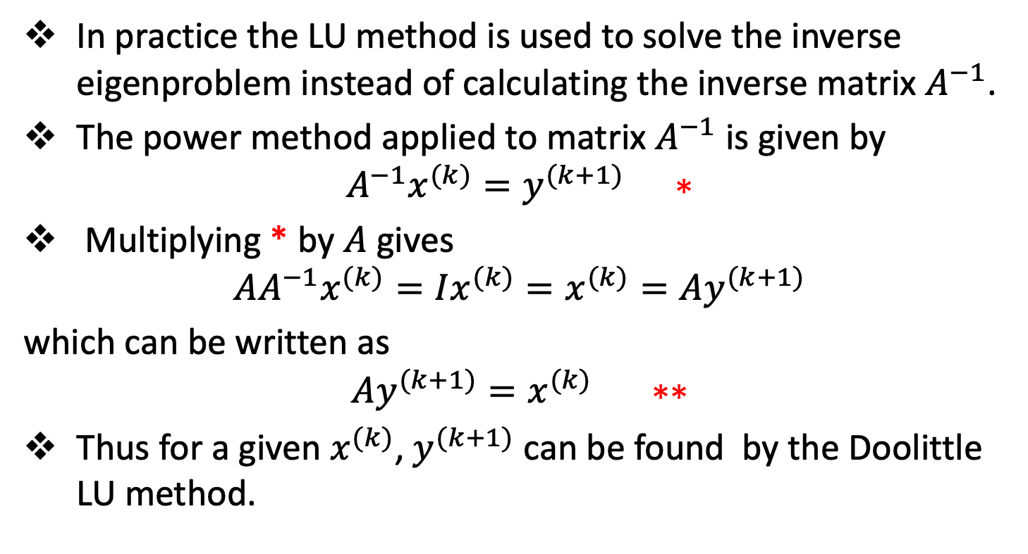
The Inverse Power Method
In practice the LU method is used to solve the inverse eigenproblem instead of calculating the inverse matrix $A^{−1}$.
The power method applied to matrix $A^{−1}$ is given by
$$A^{−1}x^{(k)}=y^{(k+1)} ∗$$
Multiplying * by $A$ gives
$$AA^{−1}x^{(k)}=Ix^{(k)}=x^{(k)}=Ay^{(k+1)}$$
which can be written as
$$Ay^{(k+1)}=x^{(k)} ∗∗$$
Thus for a given $x^{(k)}$, $y^{(k+1)}$ can be found by the Doolittle LU method.

Slide 28
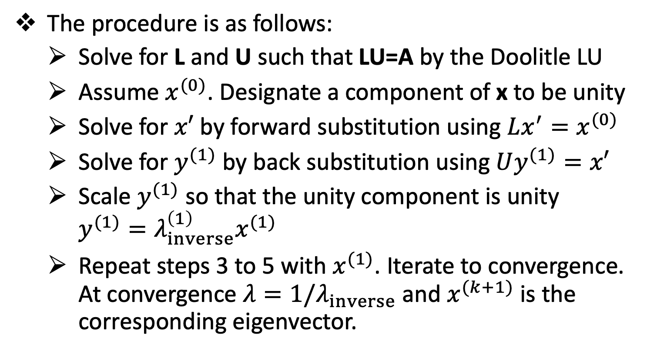
The Inverse Power Method
The procedure is as follows:
Solve for L and U such that LU=A by the Doolitle LU
Assume $x^{(0)}$. Designate a component of x to be unity
Solve for $x′$ by forward substitution using $Lx^{′}=x^{(0)}$
Solve for $y^{(1)}$ by back substitution using $Uy^{(1)}=x′$
Scale $y^{(1)}$ so that the unity component is unity $y^{(1)}=λ_{inverse}^{\left(1\right)}x^{(1)}$
Repeat steps 3 to 5 with $x^{(1)}$. Iterate to convergence. At convergence $λ=1/λ_{inverse}$ and $x^{(k+1)}$ is the corresponding eigenvector.

Slide 29
The Direct Method
Topic Three

Slide 30
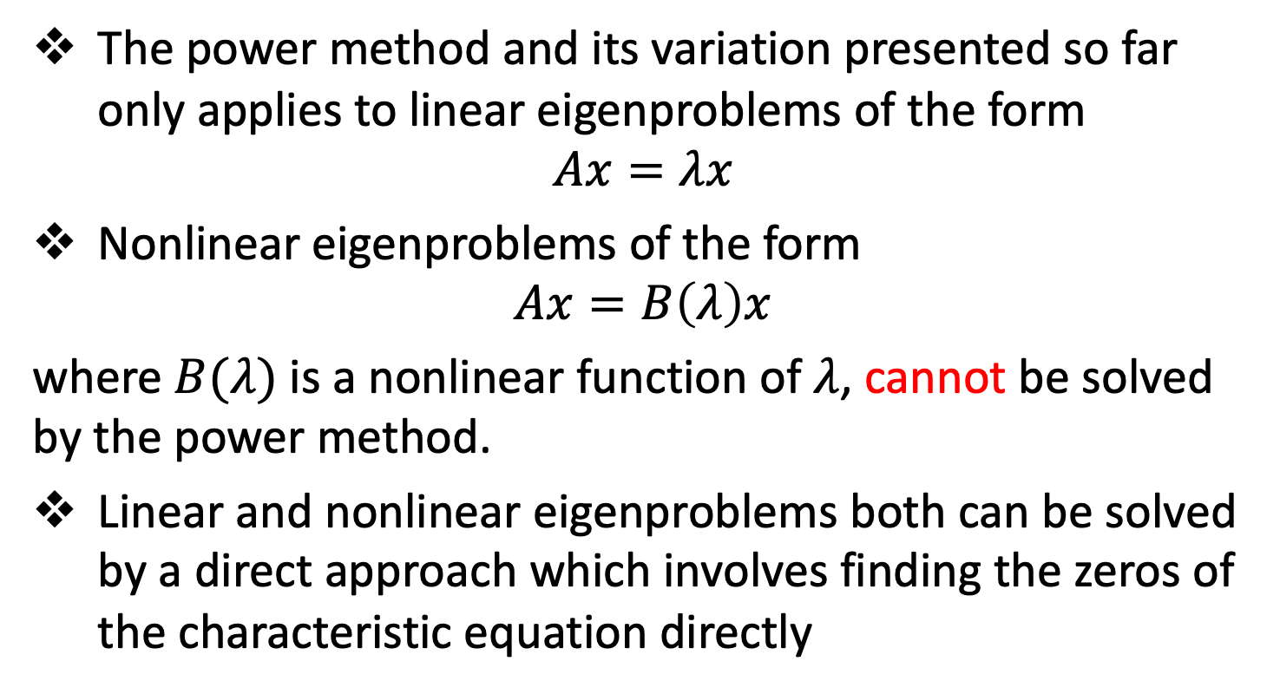
The Direct Method
The power method and its variation presented so far only applies to linear eigenproblems of the form
$$Ax=λx$$
Nonlinear eigenproblems of the form
$$Ax=B\left(λ\right)x$$
where $B(λ)$ is a nonlinear function of $λ$, cannot be solved by the power method.
Linear and nonlinear eigenproblems both can be solved by a direct approach which involves finding the zeros of the characteristic equation directly

Slide 31
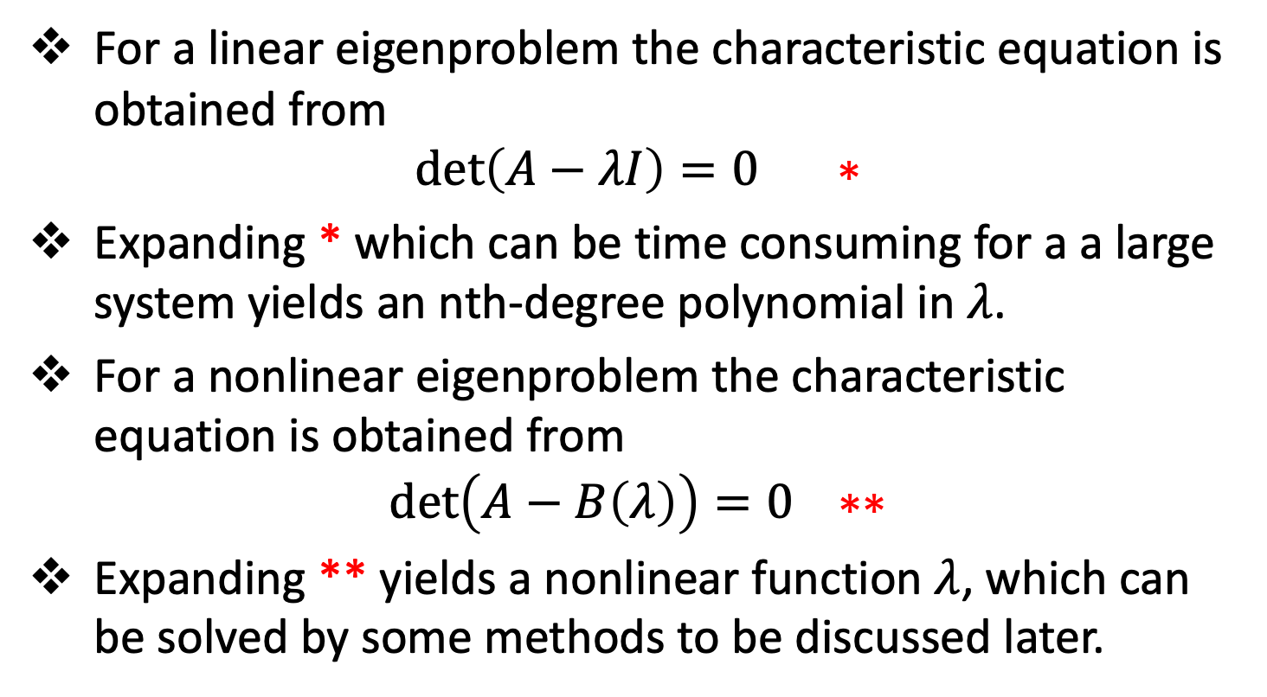
The Direct Method
For a linear eigenproblem the characteristic equation is obtained from
$$\det\left(A−λI\right)=0 ∗$$
Expanding * which can be time consuming for a a large system yields an nth-degree polynomial in $λ$.
For a nonlinear eigenproblem the characteristic equation is obtained from
$$\det\left(A−B\left(λ\right)\right)=0 ∗∗$$
Expanding ** yields a nonlinear function $λ$, which can be solved by some methods to be discussed later.

Slide 32
The Direct Method
The direct method determines only the eigenvalues.
The corresponding eigenvectors must be determined by substituting the eigenvalues into the system of equations and solving for the corresponding eigenvectors directly or by applying the inverse power method.

Slide 33
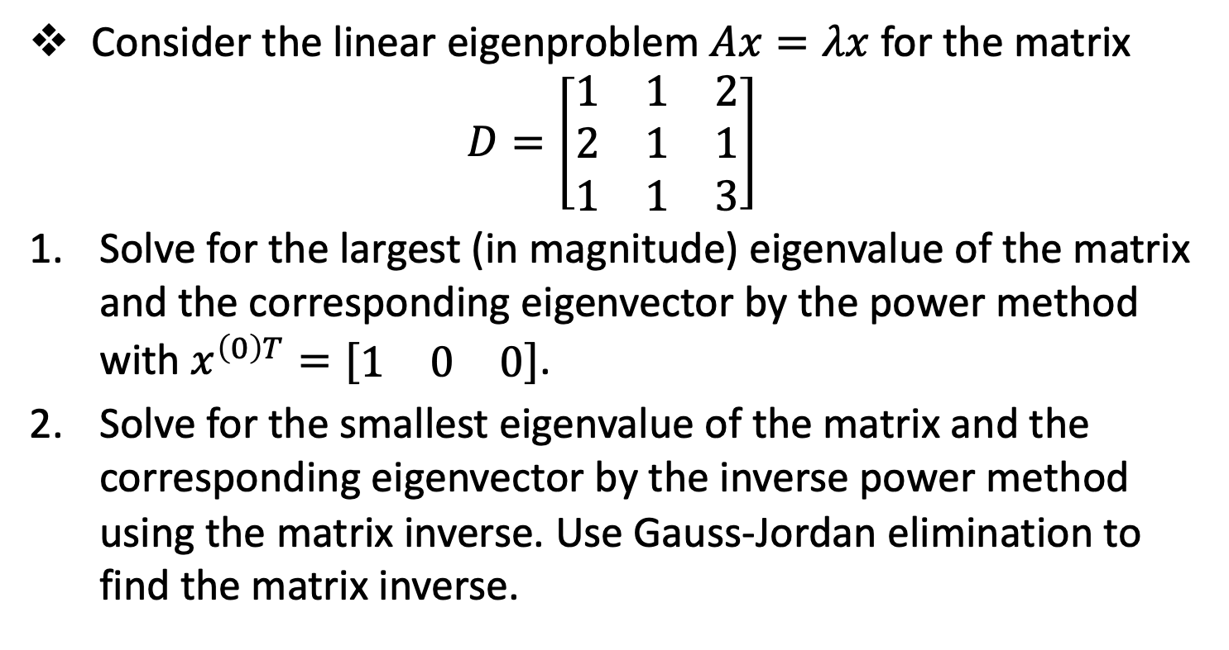
Session 3 - Assignment
Consider the linear eigenproblem $Ax=λx$ for the matrix
$$D=\left[\begin{matrix}1 & 1 & 2 \\ 2 & 1 & 1 \\ 1 & 1 & 3\end{matrix}\right]$$
Solve for the largest (in magnitude) eigenvalue of the matrix and the corresponding eigenvector by the power method with $x^{\left(0\right)T}=[\begin{matrix}1 & 0 & 0\end{matrix}]$.
Solve for the smallest eigenvalue of the matrix and the corresponding eigenvector by the inverse power method using the matrix inverse. Use Gauss-Jordan elimination to find the matrix inverse.

Slide 34
Reference
Hoffman, J. D. (2001), Numerical Methods for Engineers and Scientists (2nd Edition)
Johnston, R. L. (1982), Numerical Methods, A Software Approach, John Wiley & Sons
Kahaner, D., Moler, C., and Nash S. (1989), Numerical Methods and Software, Prentice Hall.

Slide 35
The End

